Slide 1
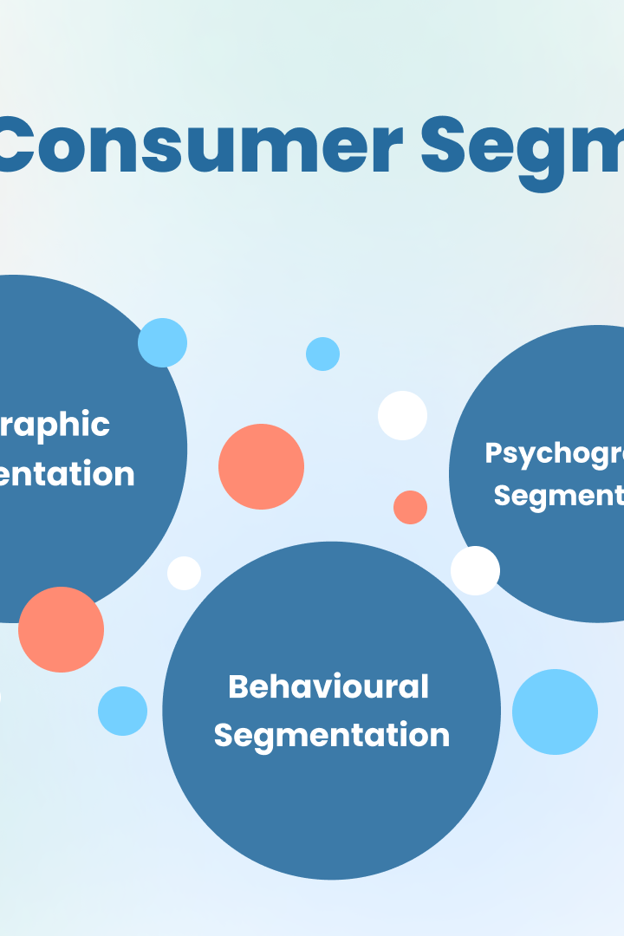
Customer Segmentation using RFM and kmeans model
Group Members
Yashraj Devrat
Anish Date
Vipashyana Jawale
Shubham Keskar
Project Mentor
Mr.P. M. Paithane

Slide 2
What is RFM and how it is used for customer segmentation?
1
Recency
2
Frequency
Measures the number of days that have passed since the customer's last transaction.
Measures the number of times the customer has engaged with the business.
3
Monetary
4
RFM Analysis
Measures the monetary value of the customer's transactions.
RFM analysis assigns scores to each customer based on these three factors and puts them into segments.

Slide 3
Overview of K-means clustering algorithm
K-means is a powerful clustering algorithm that groups customers based on their behavioral patterns. It helps businesses identify and target the right customers with personalized offers.
Step 1
Step 2
Step 3
Step 4
Select k number of clusters to form.
Randomly assign each data point to a cluster.
Calculate the mean of all points in each cluster and assign the points to the closest centroids.
Repeat step 3 until the clusters no longer change or a certain convergence criteria is met.

Slide 4
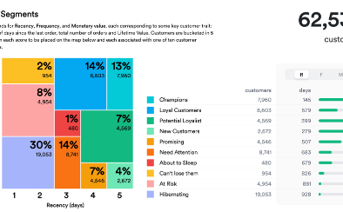
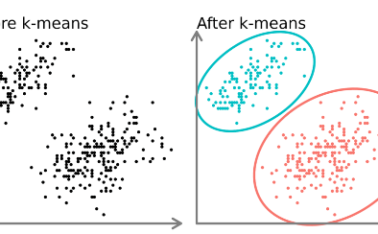
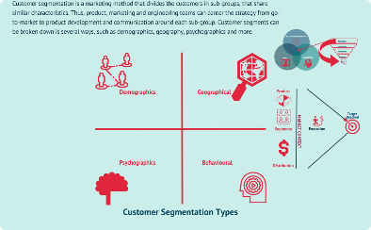
Combining RFM and kmeans for customer segmentation
Both RFM and kmeans are powerful tools on their own, but combining them leads to even more powerful insights into customer behavior. By combining these two techniques, businesses can gain a more comprehensive understanding of customers which leads to greater returns on investment.
RFM Segmentation
KMeans Clustering
Customer Segmentation
Assigning scores based on recency, frequency and monetary value can help businesses identify customer groups.
Clustering customers based on behavioral patterns with kmeans, can lead to more targeted marketing strategies.
Combining RFM and KMeans clustering offers a more powerful insight into customer behavior leading to better business outcomes.

Slide 5
Real-world examples of customer segmentation using RFM and kmeans
Retail Industry
A retail chain used RFM and kmeans to segment its customers and found that a small but valuable segment showed low customer engagement. By targeting this group with tailored promotions, the company was able to increase customer engagement and boost sales by 18%.
1
2
3
Beverage Industry
Finance Industry
Using RFM and kmeans to analyze customer behavior, a beverage company identified five distinct groups based on buying habits, allowing it to target its marketing appropriately and increase its sales by 32%.
A bank used RFM and kmeans to segment customers, and discovered that a specific high-value group exhibited a particular spending pattern. The bank tailored its programs to this group, and was able to increase its cross-selling by a 25% margin.

Slide 6
Benefits of using customer segmentation for businesses
Identify high-value customers
Segmentation leads to increased profitability
Segmentation helps businesses recognize their most important customers and target them with personalized marketing strategies.
Effective customer segmentation results in higher customer satisfaction, increased customer engagement, and thus, in turn, higher profits.
Improved communication with customers
Better decision-making abilities
With a comprehensive understanding of customer behavior, businesses can make smarter decisions when it comes to product offers, pricing and sales strategies.
Sending the right message to the right customers at the right time can improve customer communication and engagement, leading to higher retention rates.

Slide 7
Research Paper
1.Combination of Adaptive Resonance Theory 2 and RFM Model For Customer Segmentation in Retail Company.
2. An Empirical Study Study on Customer Segmentation By Purchase Behaivour Using a RFM Model and K-Means Algorithm.

Slide 8
Conclusion and key takeaways
Customer segmentation is critical for businesses to leverage the power of data analysis for improved profitability. When segmentation techniques like RFM and kmeans are used together, the insight gained can generate significant returns on investment. The benefits of segmentation include increases in customer satisfaction, profitability and retention rates, all of which are essential for long-term business growth and success.

